Slide 1
Lead Scoring Case Study
Submitted by:-
Jayati Chowdhury
Abbas Bilgrami
Tilak Hanchate

Slide 2
Problem Statement
An X Education need help to select the most promising leads, i.e. the leads that are most likely to convert into paying customers. The company requires us to build a model wherein you need to assign a lead score to each of the leads such that the customers with higher lead score have a higher conversion chance and the customers with lower lead score have a lower conversion chance. The CEO, in particular, has given a ballpark of the target lead conversion rate to be around 80%.
Goal of Case study :-
Build a logistic regression model to assign a lead score between 0 and 100 to each of the leads which can be used by the company to target potential leads. A higher score would mean that the lead is hot, i.e. is most likely to convert whereas a lower score would mean that the lead is cold and will mostly not get converted.

Slide 3
Followed Below Steps
Data Cleaning & Processing
Exploratory Data Analysis
Model Building
Data Preparations
Model Evaluation

Slide 4
Data Visualization

Slide 5
Data Analysis
Categorical Attribute Analysis
Numerical Attribute Analysis

Slide 6
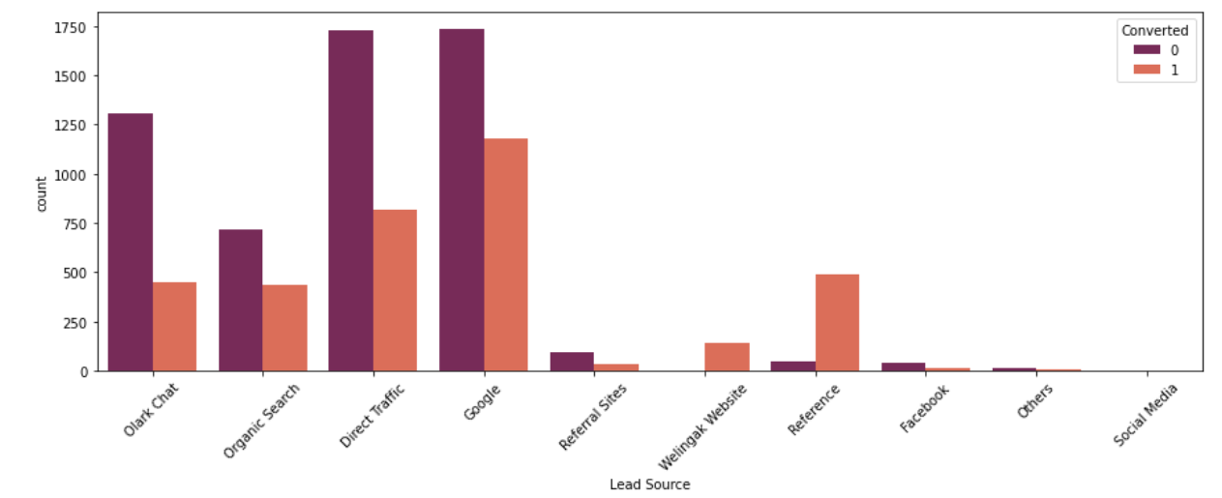
Lead Source Distribution against Conversion
Maximum Leads are generated by Google and Direct Traffic.
Conversion rate of Reference and Welinkgak Website leads is the highest.

Slide 7
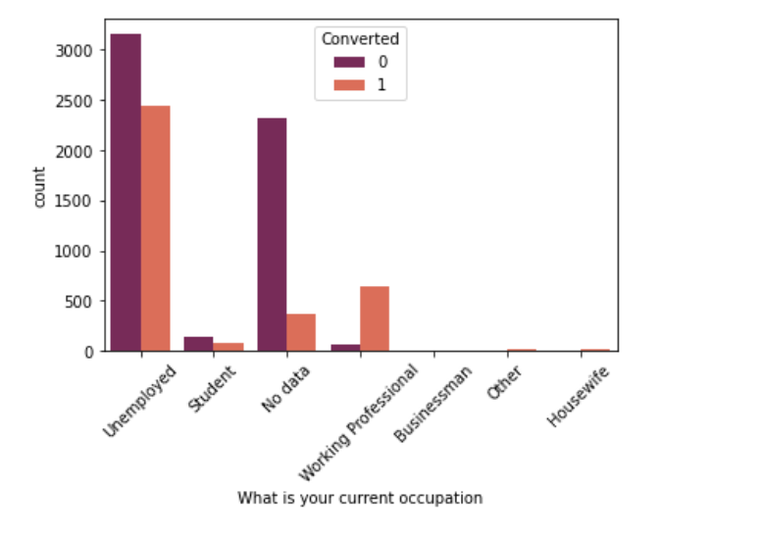
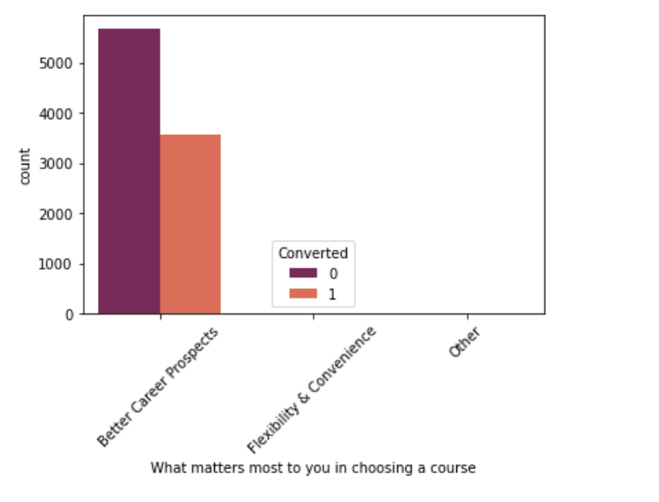
Occupation & Prospects Against Conversion
More Leads on ‘Better Career Prospects’ feature
Maximum leads generated are unemployed and their conversion rate is more than 50%.
Conversion rate of working professionals is very high.

Slide 8
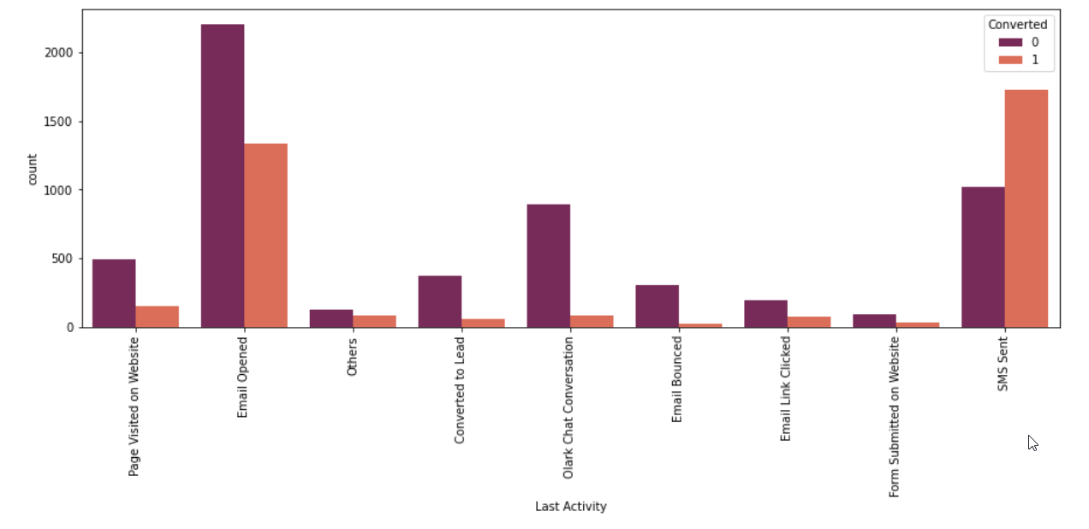
Last Activity Against Conversion
Maximum leads are generated having last activity as Email opened, but the conversion rate is not satisfactory.
Last activity as SMS sent has high conversion rate.

Slide 9
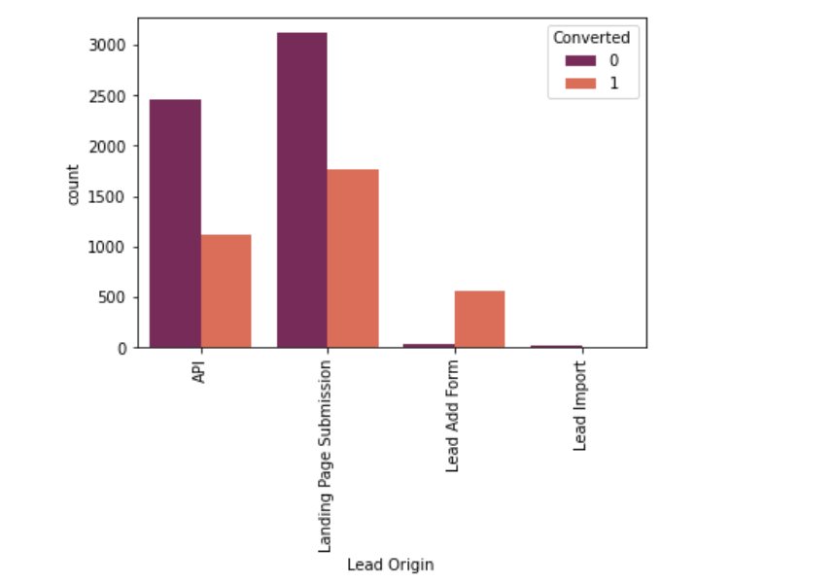
Lead Origin Against Conversion
More Leads on ‘Landing Page Submission’ Feature

Slide 10
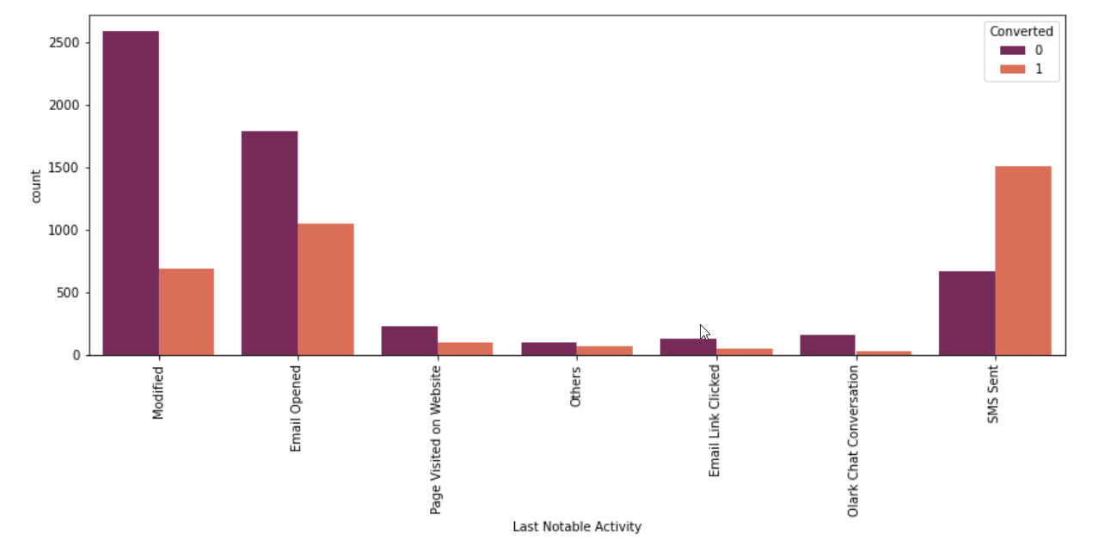
Last Notable Activity Against Coversion
Maximum leads are generated having last activity as 'Email opened' but conversion rate is not satisfactory.
Last activity as 'SMS sent' has high conversion rate.

Slide 11
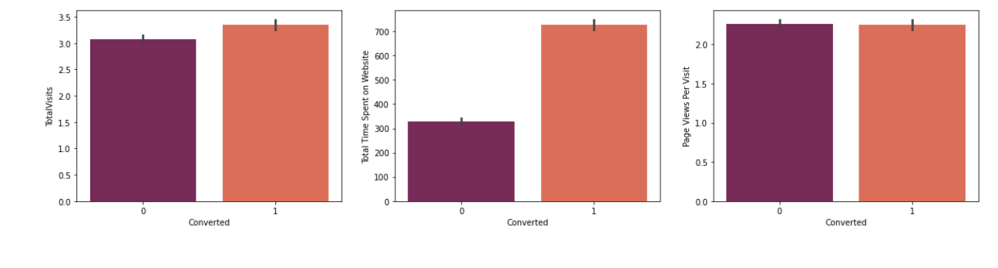
Numerical Attribute Analysis Against Conversion
The conversion rate is high for Total Visits, Total Time Spent on Website and Page Views Per Visit

Slide 12
Model Evaluation

Slide 13
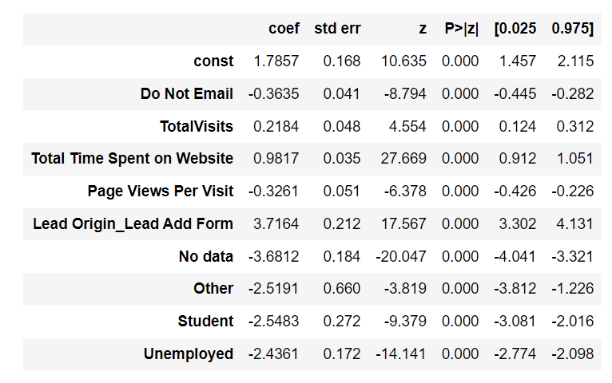
Final Model Summary –All P Values Are Zero
Important features depending on the co-efficient of Final Model are
a)Lead Origin_Lead Add Form ,b)Total Time Spent on website ,c)Total Visits

Slide 14
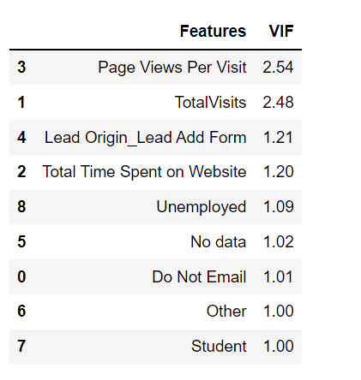
Calculating VIF –on Final Model
All variables have a good VIF value. So we need not drop any more variables and we can proceed with making predictions using this model.

Slide 15
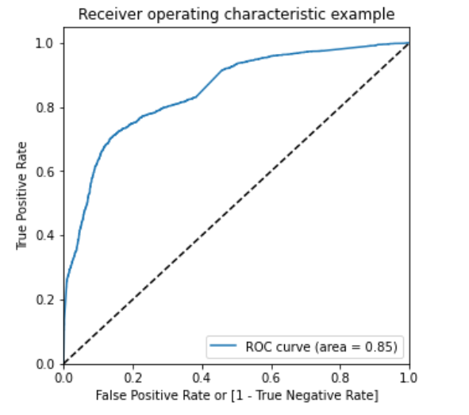
ROC Curve-Area Under Curve 0.85

Slide 16
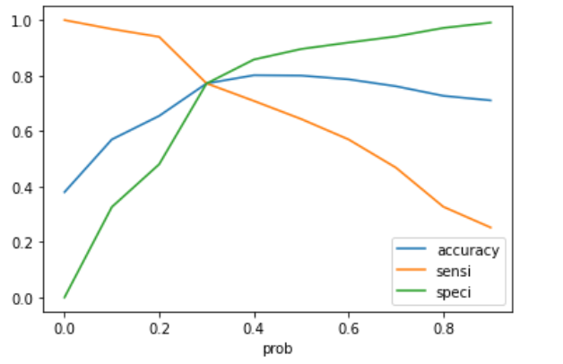
Finding Optimal Threshold
Showing changes in Sensitivity, Specificity, Accuracy with changes in the probability threshold values.
Optimal Cut-off = 0.30

Slide 17
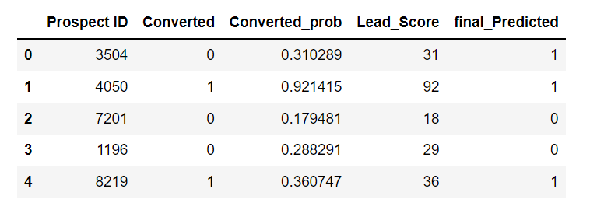
Assigning Lead Score

Slide 18
Conclusions

Slide 19
Inferences & Recommendations
After running the model on the Test Data these are the figures we obtain:-
Accuracy : 77.00%
Sensitivity :76.2%
Specificity : 77.50%
we have checked both Sensitivity-Specificity as well as Precision and Recall Metrics, we have considered the optimal cut off based on Sensitivity and Specificity for calculating the final prediction.
Accuracy, Sensitivity and Specificity values of test set are around 77%, 76% and 77.5% which are approximately closer to the respective values calculated using trained set.
Also the lead score calculated in the trained set of data shows the conversion
Rate on the final predicted model is around 80%
And three important feature depending on the co-efficient of Final Model are
a)Lead Origin_Lead Add Form ,b)Total Time Spent on website ,c)Total Visits
These three features are contributing more towards the probability of the Final Model.
So from the analysis this is clear that mainly using these features like Lead Origin_Lead Add Form ,Total Time Spent on website ,Total Visits
Student , Unemployed, Page Views Per Visit we can calculate the final probable lead score.

Slide 20

Thank You

